Slide 1
Employee Data Analysis using Excel
STUDENT NAME: KEERTHANA .G
REGISTER NO: 9BF61D53DCBC5E3A33E47E5786A76D22, 312208828
DEPARTMENT: B.COM (GENERAL)
COLLEGE: MEENAKSHI COLLEGE FOR WOMEN

Slide 2
PROJECT TITLE
Employee Performance Analysis Based On Gender, Work Location And FTE using Excel

Slide 3


AGENDA
Problem Statement
Project Overview
End Users
Our Solution and Proposition
Dataset Description
Modelling Approach
Results and Discussion
Conclusion
3/21/2024 Annual Review

Slide 4

PROBLEM STATEMENT
The goal is to analyze the distribution of Full-Time Employees (FTEs) across various locations, considering gender and any missing data. The data provided includes the number of male, female, and unclassified employees across the locations: Auckland, Chennai, Columbus, Hyderabad, Remote, Seattle, and Wellington.

Slide 5

PROJECT OVERVIEW
.
This project analyzes the Full-Time Equivalent (FTE) distribution by gender across departments. The total FTE is 175, with 85.4 for females, 83.7 for males, and 5.9 unspecified. Key insights include significant female representation in Marketing (13.2 FTEs) and balanced gender distribution in other departments. However, discrepancies exist, such as in a department with 16.9 FTEs, where males dominate. The project aims to address these gender imbalances and improve data accuracy across the organization.

Slide 6

WHO ARE THE END USERS?
HR MANAGERS
ACCOUNTANTS
DATA ANALYSTS
DEPARTMENT HEADS
PAYROLL ADMINISTRATORS
RECRUITMENT TEAMPROJECT AND
OPERATION MANAGERS

Slide 7

OUR SOLUTION AND ITS VALUE PROPOSITION
FILTERING – REMOVE VALUES
PIVOTAL TABLE – SUMMARY OF EMPLOYEE PERFORMANCE
LINE DIAGRAM - FIINAL REPORT

Slide 8
Dataset Description
EMPLOYEE DATA SET-NAAN MUDHALVAN PORTAL 9 FEATURES EMPLOYEE ID: ALPHA, NUMERICAL NAME: ALPHABETICAL[TEXT] DEPARTMENT: ALPHABETICAL[TEXT] SALARY: NUMERICAL START DATE : ALPHA, NUMERICAL EMPLOYEE TYPE : ALPHABETICAL[TEXT]
3 FEATURES USED WORK LOCATION : ALPHABETICAL[TEXT]
GENDER: ALPHABETICAL[TEXT] FTE : NUMERICAL

Slide 9

THE "WOW" IN OUR SOLUTION
The solution's "wow" factor lies in its clear, balanced representation of FTE distribution across global locations, categorized by gender. This detailed breakdown highlights workforce geographical spread and emphasizes gender parity within each location. The straightforward data presentation enables quick insights into workforce demographics, allowing users to assess diversity and equity across regions. Its simplicity and clarity make this analysis a powerful tool for understanding and optimizing global workforce allocation, enhancing strategic decision-making with ease.
3/21/2024 Annual Review
9

Slide 10
MODELLING
STEP-1 DOWNLOAD THE EMPLOYEE DATASET IN NAAN MUDHALVANPORTAL AND OPEN THE EXCEL.
STEP-2 SELECT THE DATA AND CLICK ON FILTER OPTION.
STEP-3 FILTER FTP IN ASSCENDING ORDER(A TO Z).
STEP-4 SELECT THE ENTIRE DATA AND CLICK ON INSERT AND CLICK ONPIVOT TABLE TO CREATE PIVOT TABLE.
STEP-5 DRAG THE NEEDED DATA AND CREATE A PIVOT TABLE
STEP-6 SELECT THE PIVOT TABLE, CLICK ON INSERT-CHOOSE THE TYPEOF CHARTS ACCORDING TO ONE'S REQUIREMENT. TYPE OF CHART USED IN THIS ANALYSIS IS BAR DIAGRAM.
STEP-7 THE TABLE AND CHART IS BEING CREATED, WHICH HELPS IN BETTER UNDERSTANDING AND INTERPRETATION OF DATA
10

Slide 11
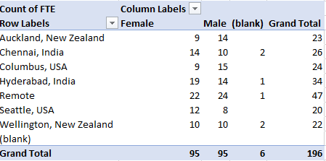
RESULTS 1.
11

Slide 12
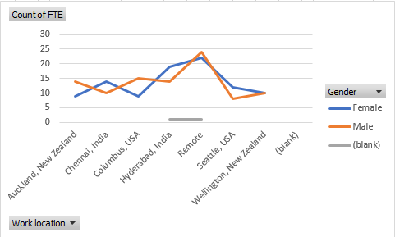
RESULTS 2.

Slide 13
Conclusion
This project aims to analyze the distribution of Full-Time Employees (FTEs) across different global locations, with a focus on gender and identifying any missing data. The analysis will provide insights into workforce composition and help guide future human resources strategies. The data covers FTE counts for male, female, and unclassified (blank) employees across seven key locations. Additionally, there is a category labeled "(blank)" that likely represents missing or unclassified data

